Slide 1
Database creation using R
Dr. S. Azarudheen
Assistant Professor
Department of Statistics
CHRIST University

Slide 2
Why R?
R is an interpreted language, not compiled one
All commands typed on the keyboard are directly executed.
It does not require to build a complicated programs for each function as other programs (e.g., C, C++ etc.,)
R syntax is very simple and intuitive
For instance to get the sum of two numbers the function is sum(a,b)

Slide 3
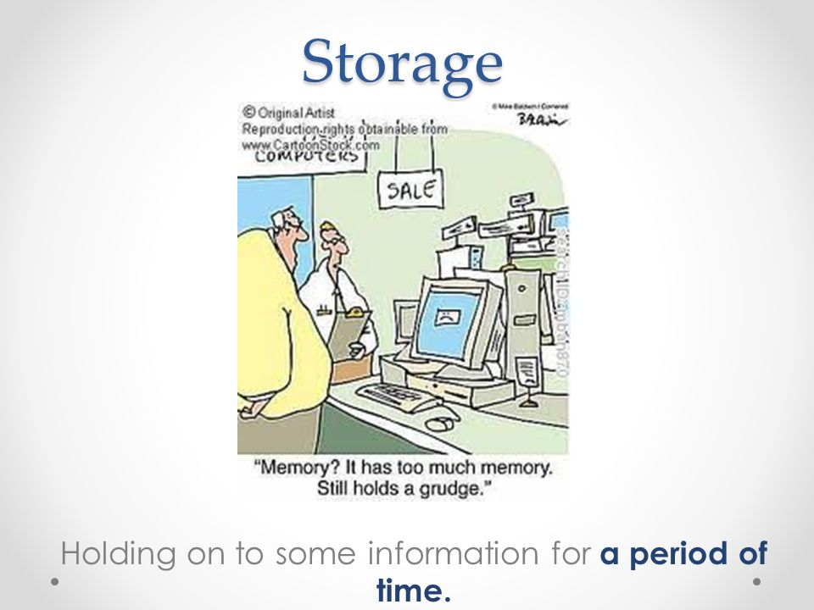
The Storage process
R stores the running variables, data, functions results etc., in the active memory of the computer in the form of objects which have names.
No temporary files are created
The readings and writings of files are used for input and output of data and results.
The results are displayed directly on screen, stored in an object or written on disk.
Data files can be read from the local disk or from a remote server through internet.

Slide 4
R command prompt
> n <- 15
> n
> 5 -> n
> n
> x <- 1
> X <- 10
> x
> X
> n <- 10 + 2
> n
> n <- 3 + rnorm(1)
> n
> (10 + 2) * 5
> a <- print(20+30)
> B <- print(a*X)
[1] 500

Slide 5
Data manipulation
> data <- c(1,2,3,4)
> data
>x <- 1:30
> 1:10-1
> 1:(10-1)
> seq(1, 5, 0.5)
> z <- scan()
1: 1.0 1.5 2.0 2.5 3.0 3.5 4.0 4.5 5.0
10:
Read 9 items
> z
> sequence(4:5)
> sequence(c(10,5))

Slide 6
Generating levels
> gl(3, 5) */ gl stands for generate levels, number of levels and number of replications
> gl(3, 5, length=30)
> gl(2, 6, label=c("Male", "Female"))
> gl(2, 10)
> gl(2, 1, length=20)
> gl(2, 2, length=20)

